Slide 1
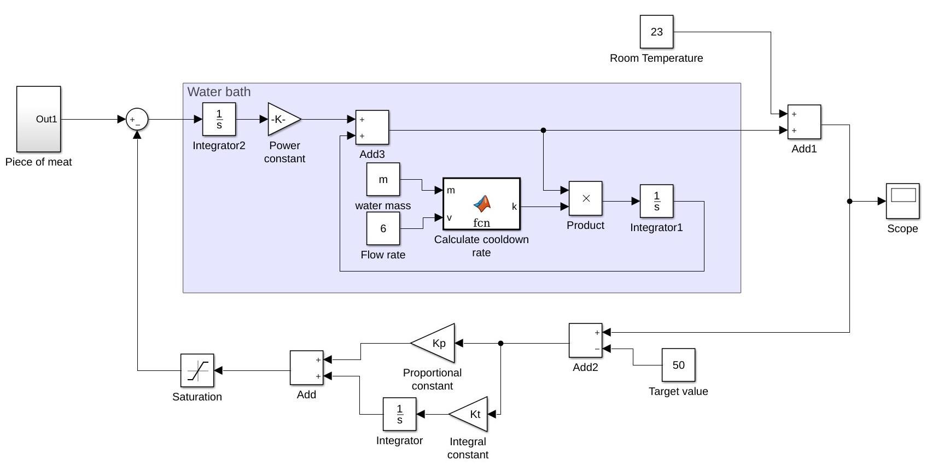
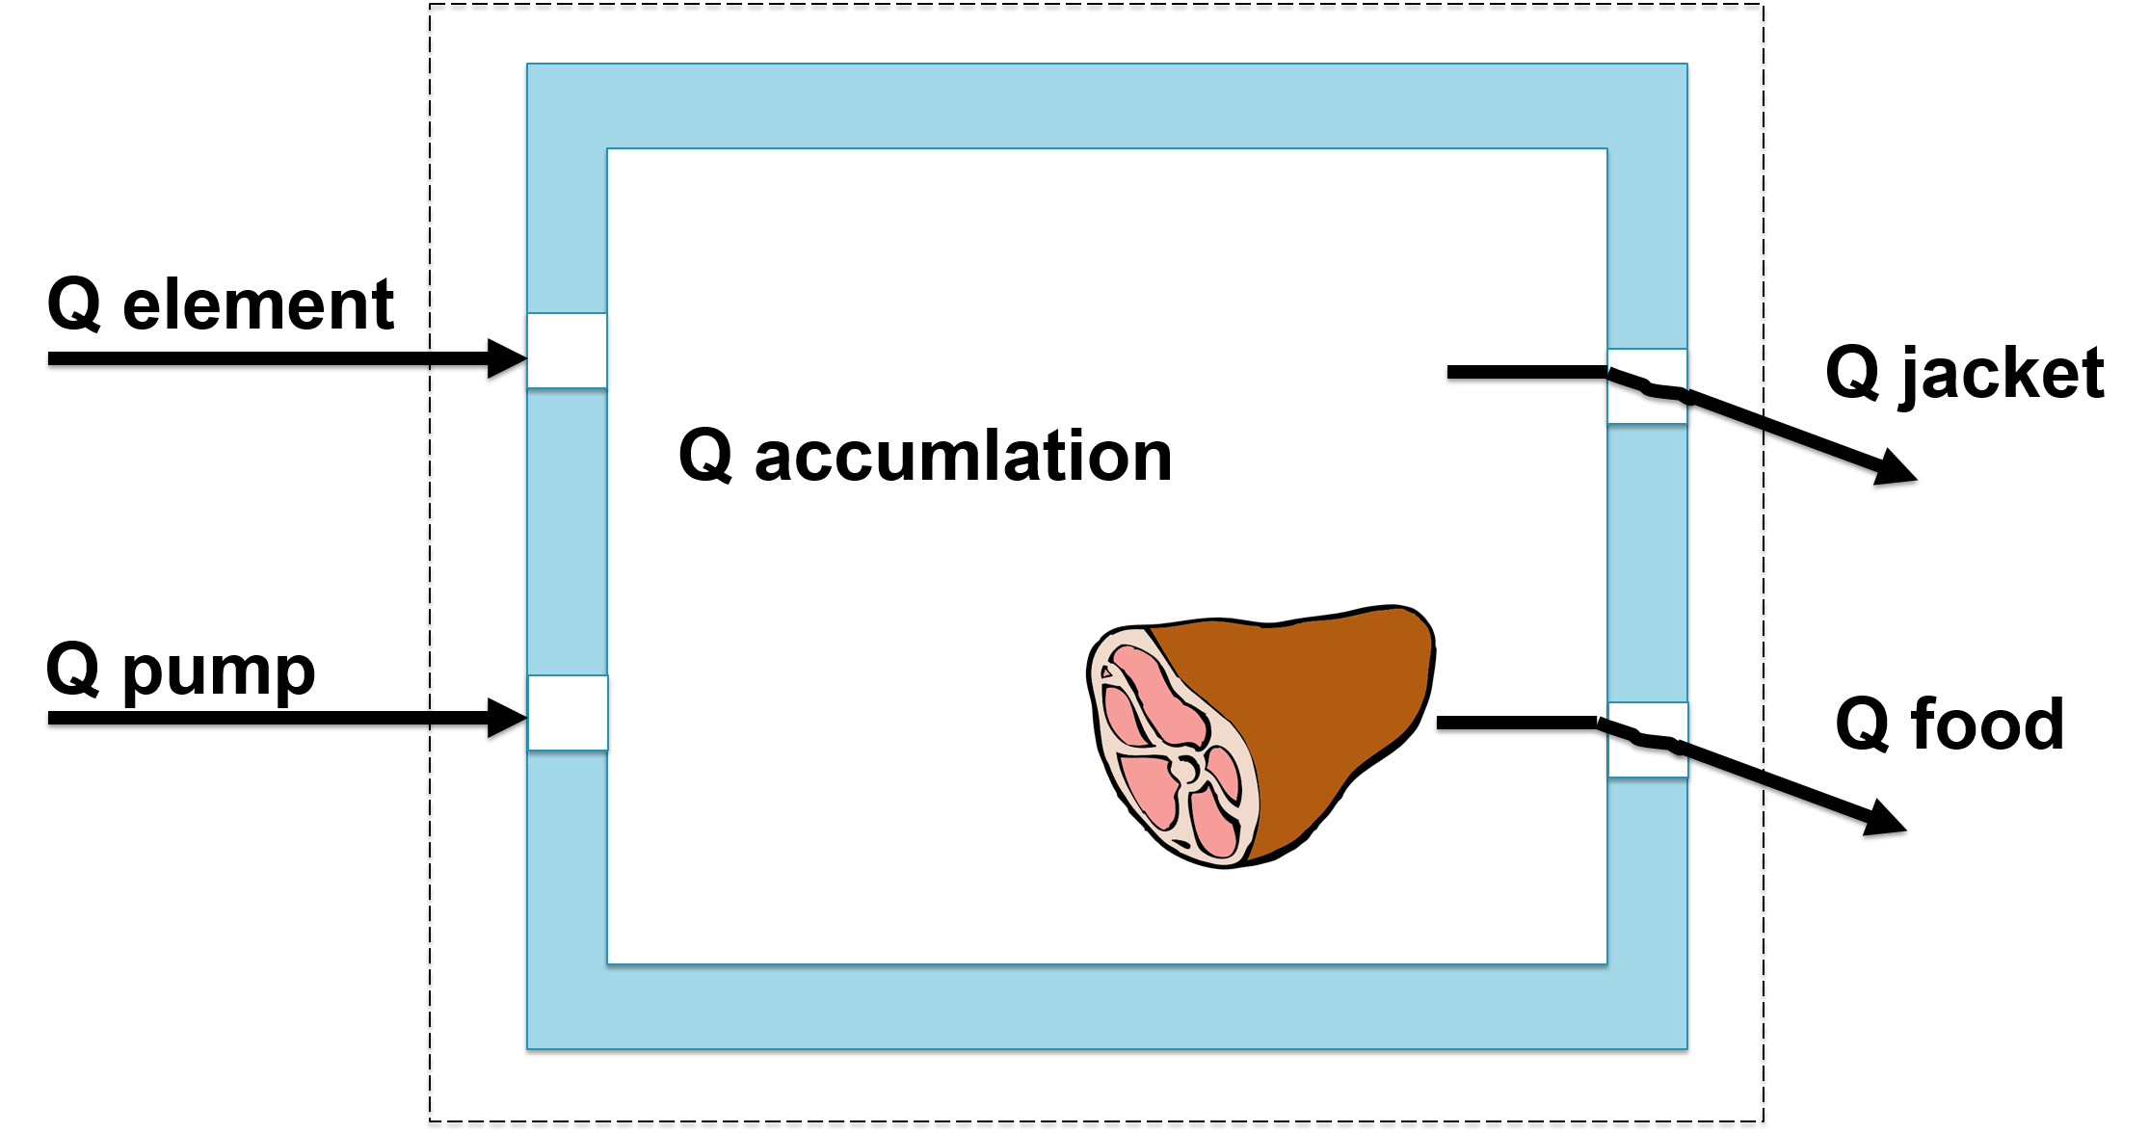

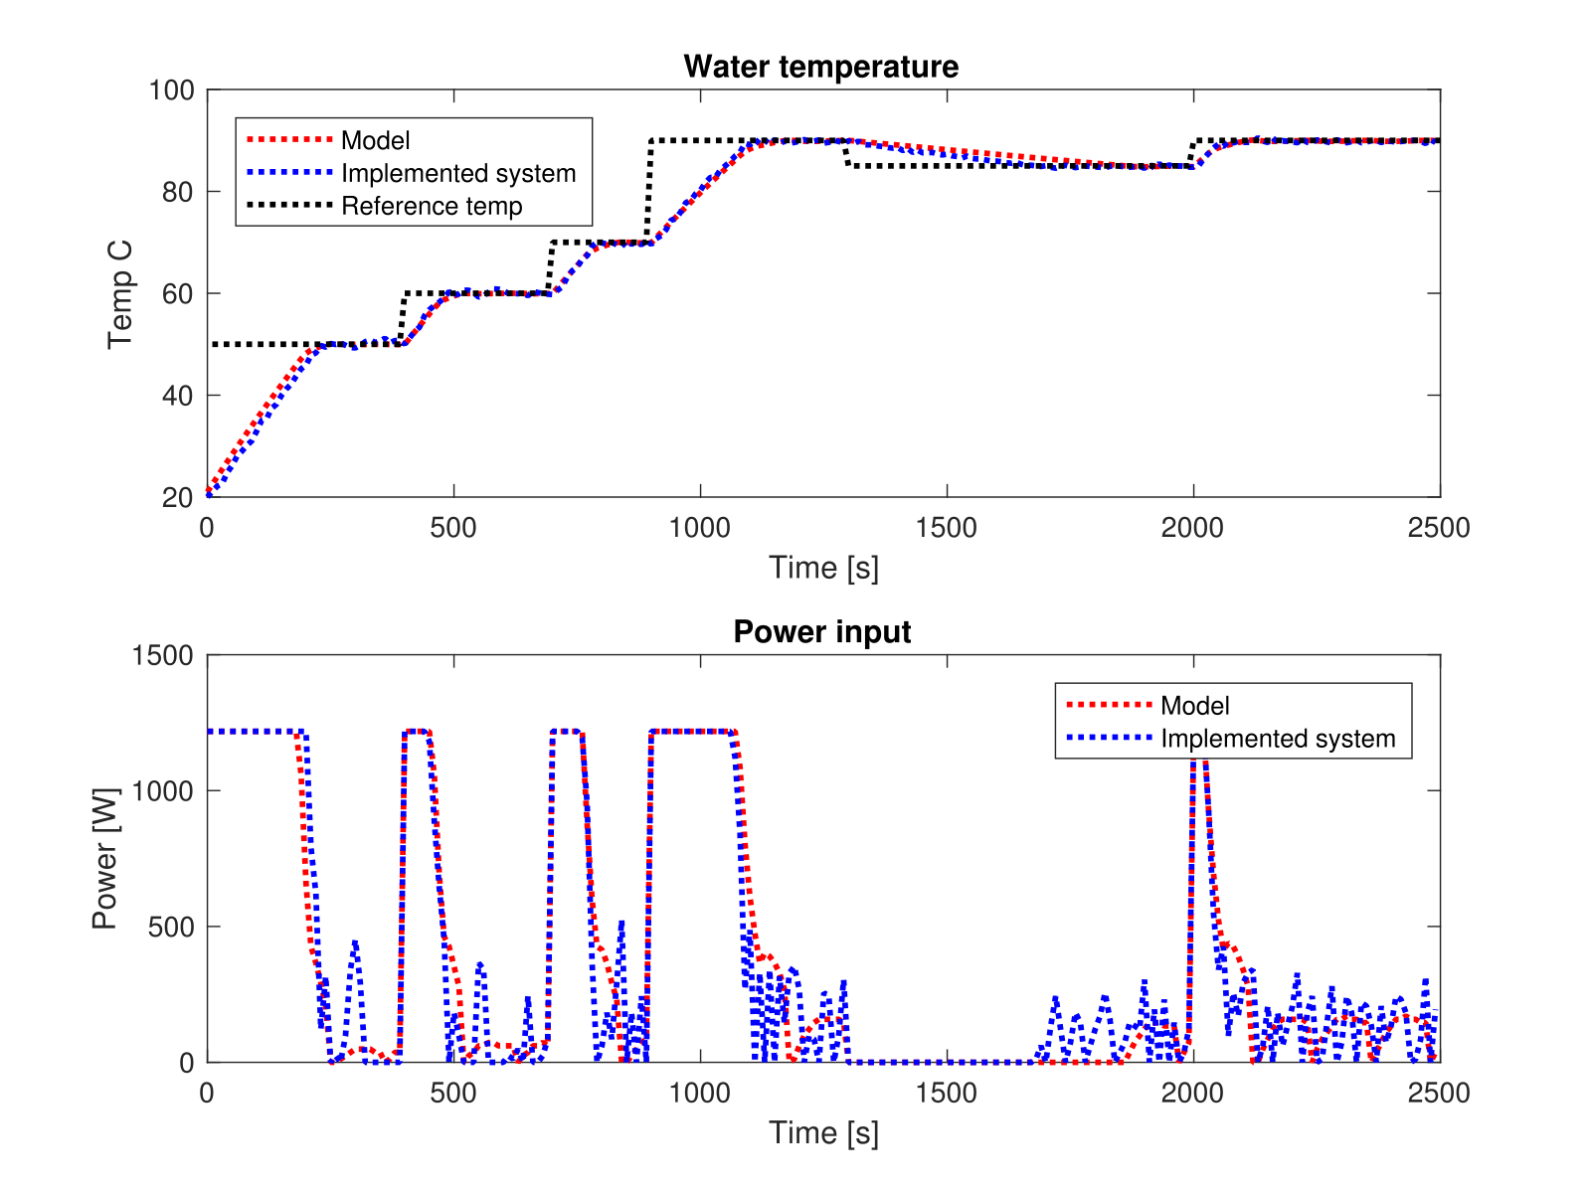
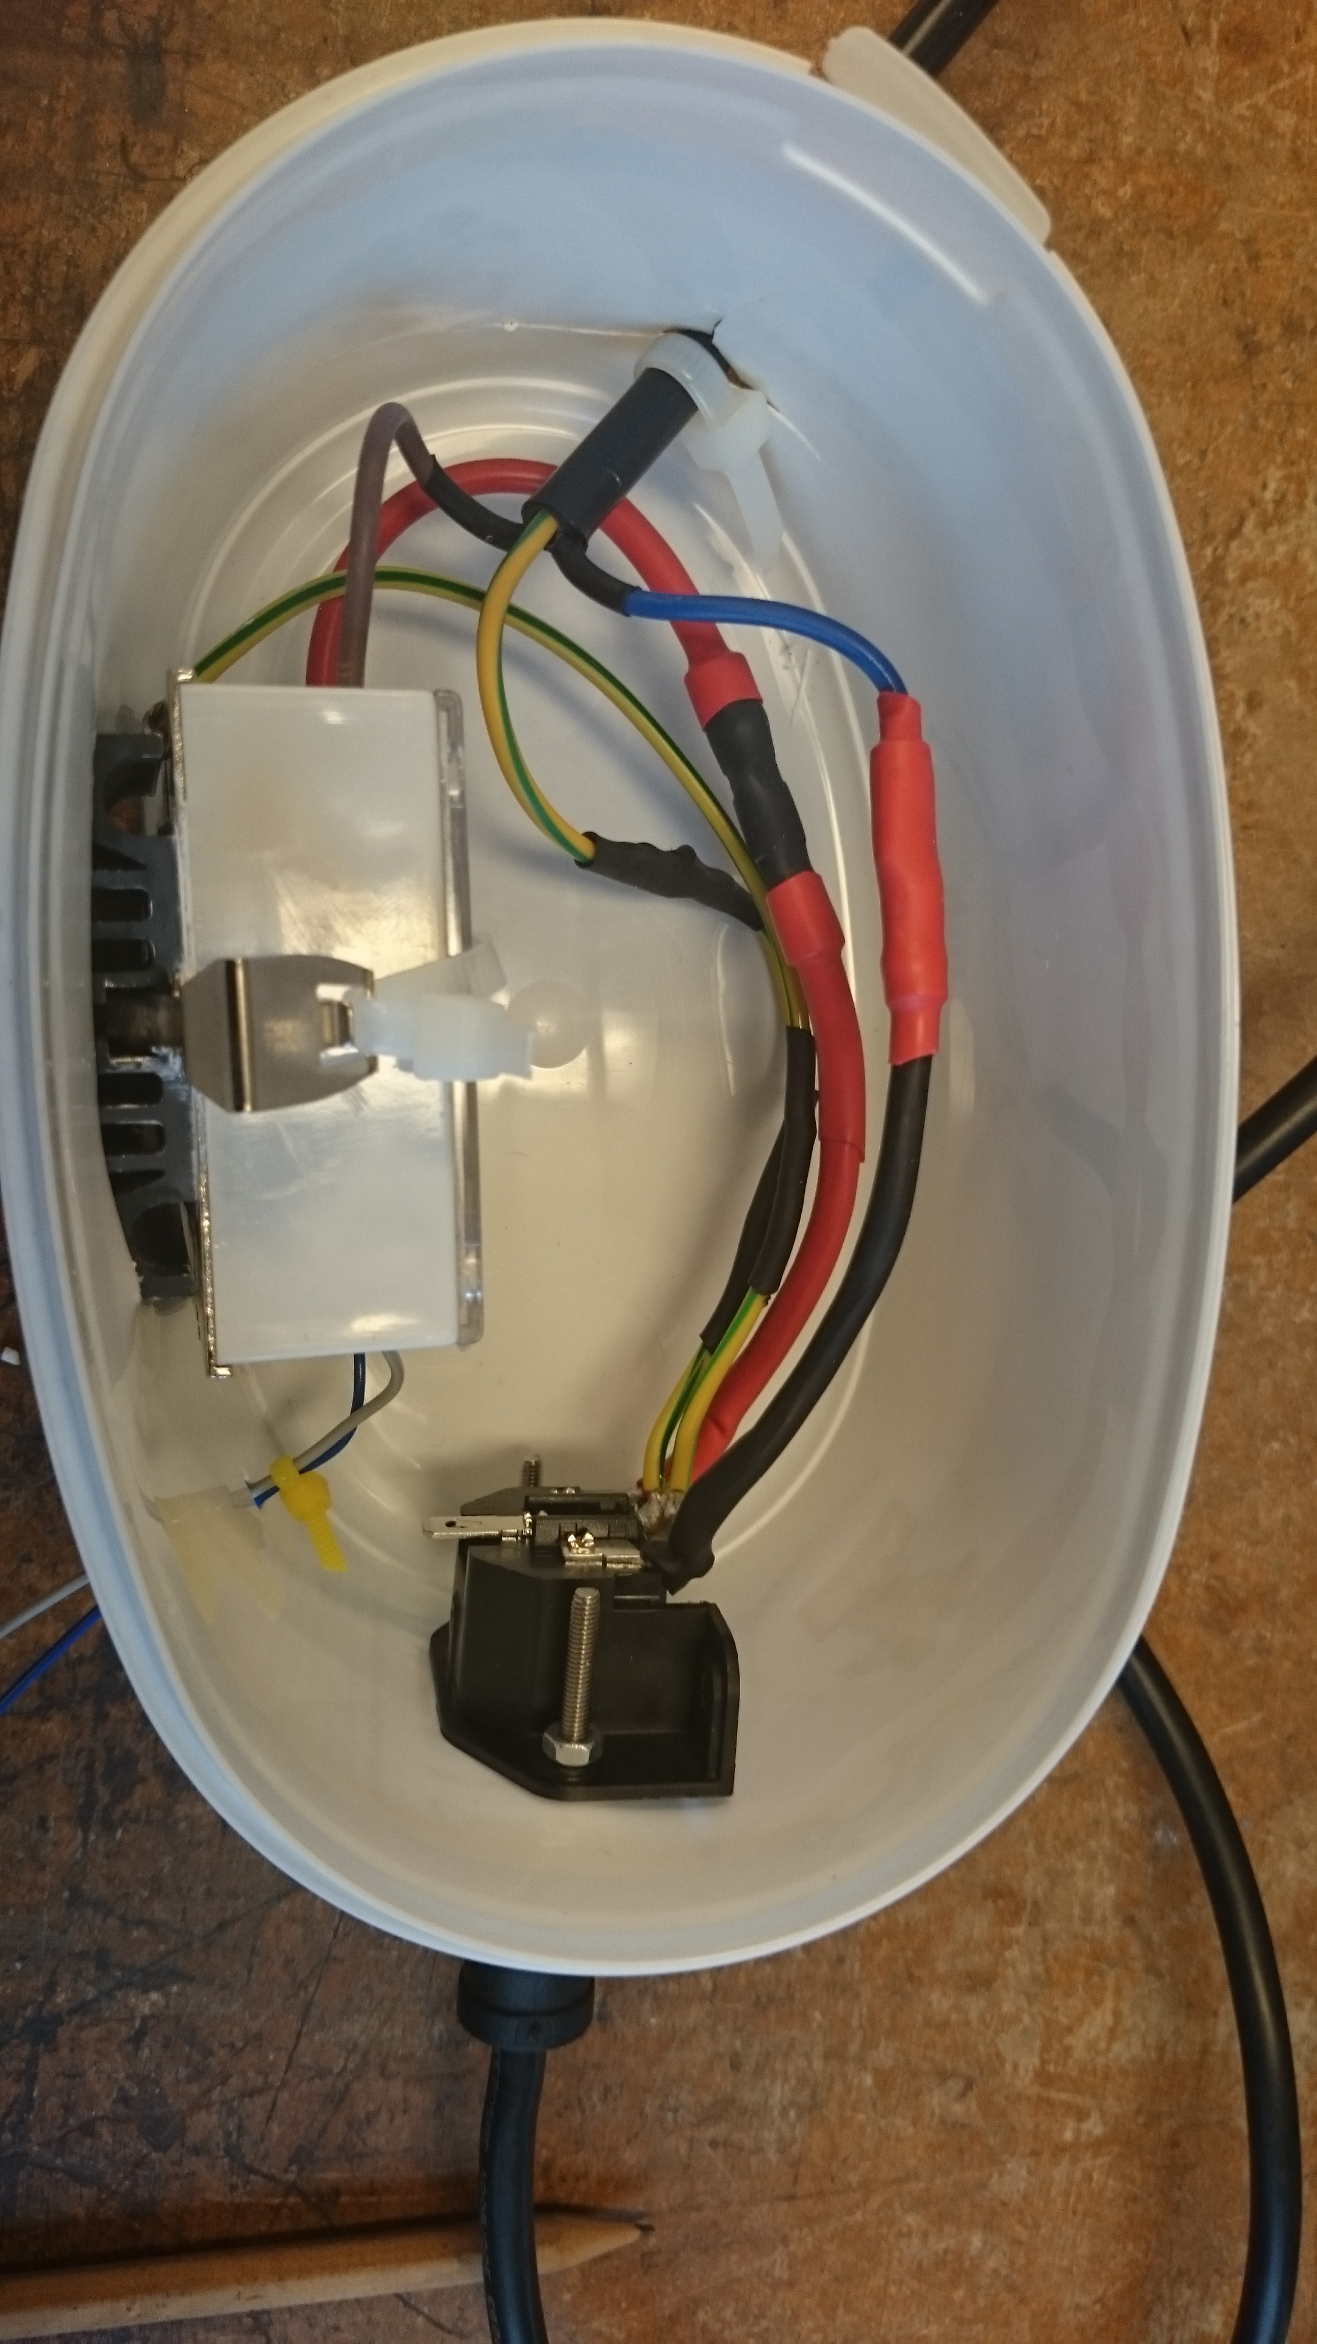
Control of Sous Vide Cooking Device
Design project in systems, control and mechatronics
Marcus Björklund, Josefine Södling and Tonja Heinemann
Cooking the perfect eggs
Overview
System Identification
Cooking sous vide means putting food in airtight sealed plastic bags and leaving it in a water bath for a long time at a constant temperature.
To ensure a constant temperature with the device used for the project, a model has been created. With this model, a control algorithm has been designed.
The control algorithm is implemented on an Arduino Mega 2560 which can also be used for a lot of additional features like user interfaces or internet of things connectivity.
Based on formulas, a first model was created. Measurements of the system were then used to improve the model.
The model and the controller were combined to simulate the system in Simulink.
Model of the system
Proof of concept
The modelled system and the real water bath were analyzed in terms of their reference tracking behaviour. The plot shows this experiment with the temperature in the upper panel and the power input into the system in the bottom panel.
Model of the Sous Vide cooking device.
The formulas for the model are based on the energy balance off the system.
Q_{accumulation} = Q_{element} + Q_{pump} - Q_{jacket} - Q_{food}
Hardware added to the system
This picture shows the solid state relay added to the heating element circuit, in order to control it.

